Slide 1
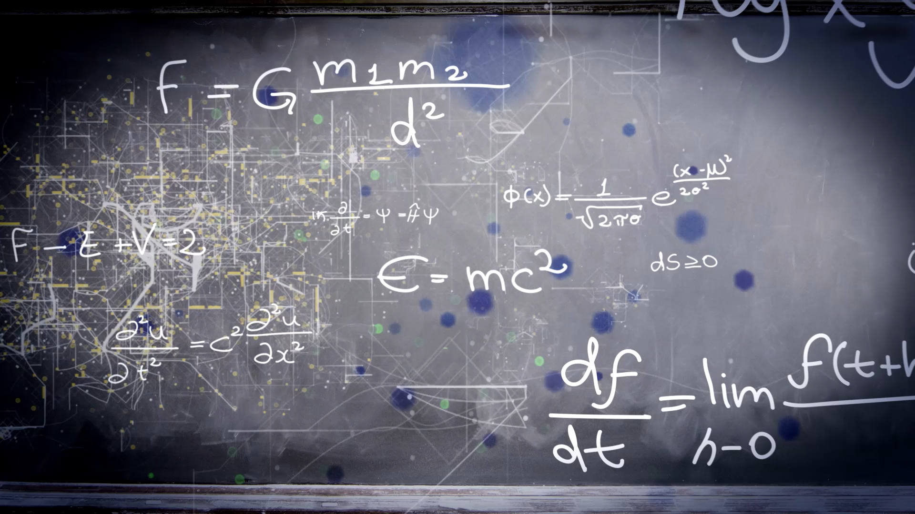
Phase 1, Module 4: Operators & Logic Engines
Khyber AI Systems Engineer (KASE)
Welcome to Module 4. An AI is just a massive calculator making logical decisions millions of times per second. Today, we learn the mathematical and logical operators that drive those decisions.
Presented By: Zaryab Ahmad

Slide 2
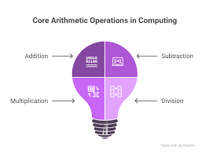

Core Arithmetic (The AI Lens)
Feature Scaling $(+, −, ∗, /)$
$+ / −:$Used for adjusting AI "Biases" or centering data.
*: Used for applying "Weights" to data.
/: Crucial for Normalization (e.g., dividing image pixels by 255 so the AI can process them faster).

Slide 3

Exponents & The Cost of Being Wrong
Exponentiation $(∗∗)$
In Python, $^$ is NOT an exponent (it's a bitwise operator).
Use ** for powers (e.g., 2 ** 3 = 8).
AI Use Case: Used constantly to calculate "Mean Squared Error" — mathematically punishing the AI when it makes a wrong prediction.

Slide 4
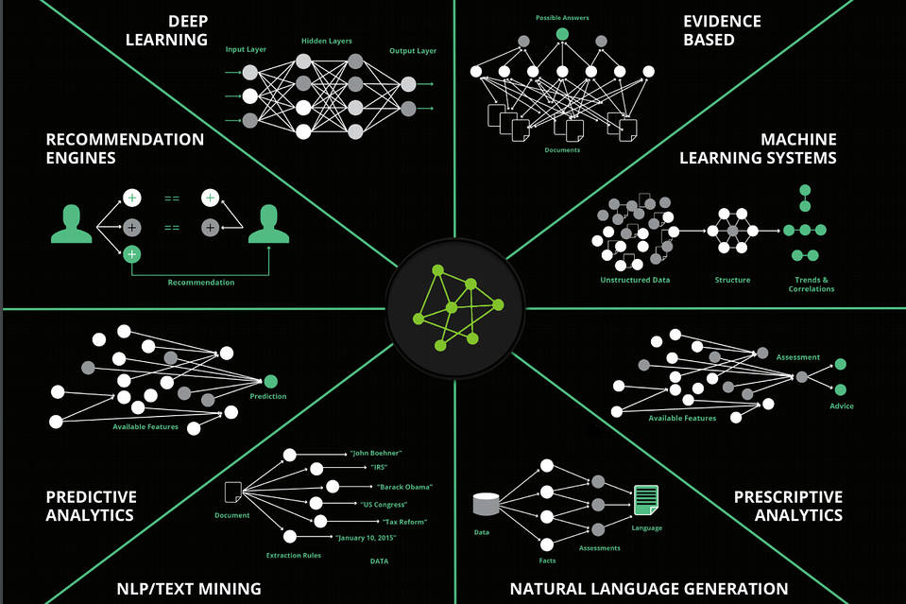

The Math of AI (Beyond Addition)
Floor Division & Modulo
Standard Division ($/$): Always returns a Float (decimal).
Floor Division ($//$): Chops off the decimal. Returns an Integer. (Crucial for splitting data into batches).
Modulo ($\%$): Returns the remainder of division. (Used to trigger events, like saving an AI model every 10 epochs).
This Photo by Unknown Author is licensed under CC BY-NC

Slide 5
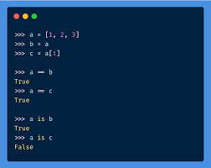

The Interview Trap (== vs is)
Value Equality vs. Memory Identity
$==:$ Do these two variables hold the exact same value?
is: Are these two variables pointing to the exact same address in RAM?

